Slide 1
Predictive Modeling Project: Time Series Prediction
Group #3: Baiting Gai, Xixiang Chen, Yuyan Wang, Xingyu Ye, Mengying Jiang

Slide 2
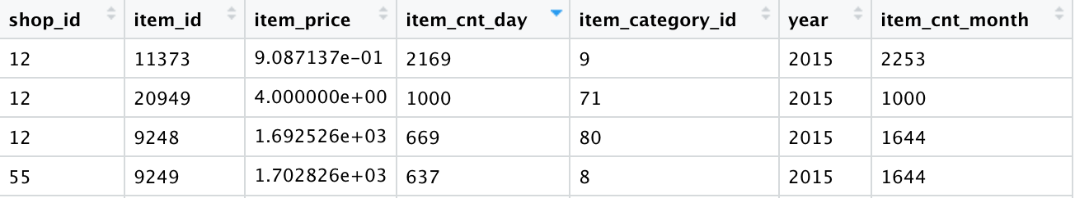
Data Description & Background
Data Source
Kaggle Competition: Predict Future Sales
1C Company
Goal
Describe the daily total sales

Slide 3
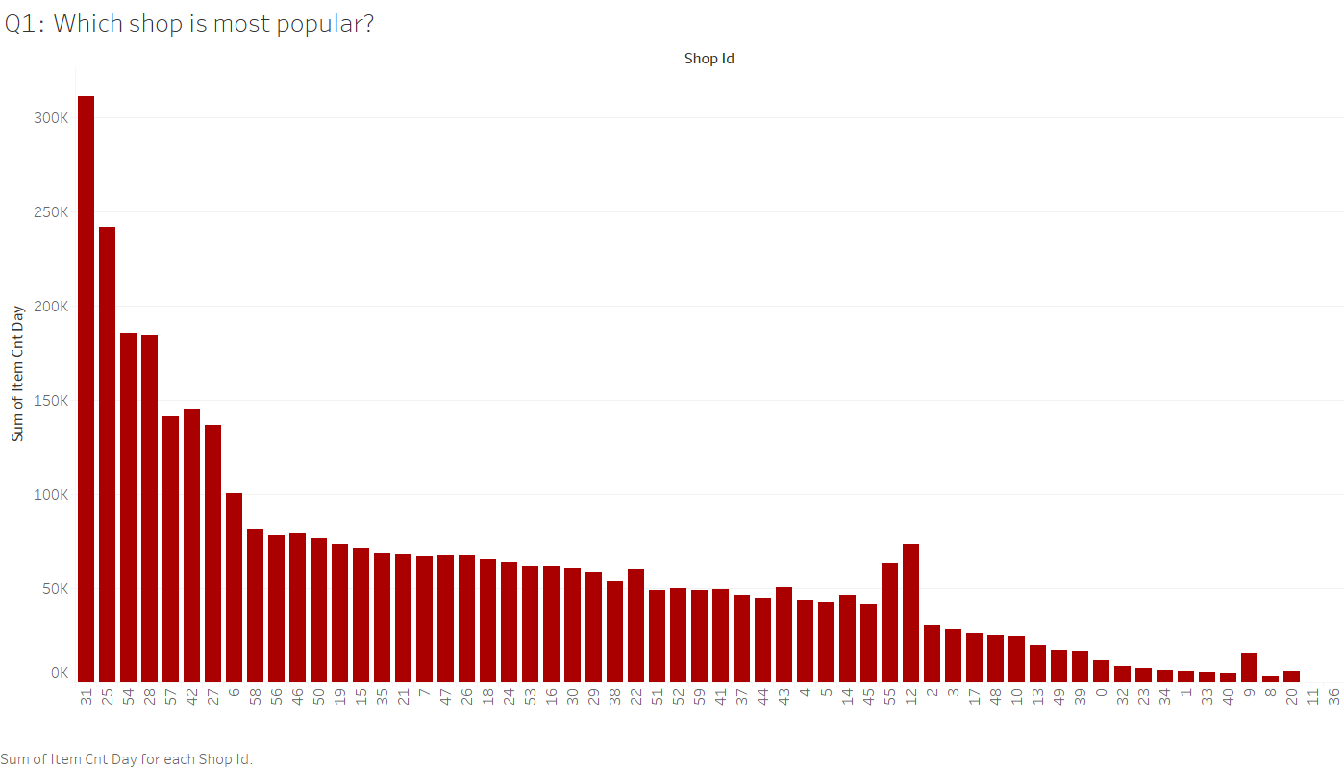
Exploratory Data Analysis
Figure 2.1: Total Transaction Quantities of Each Shop

Slide 4
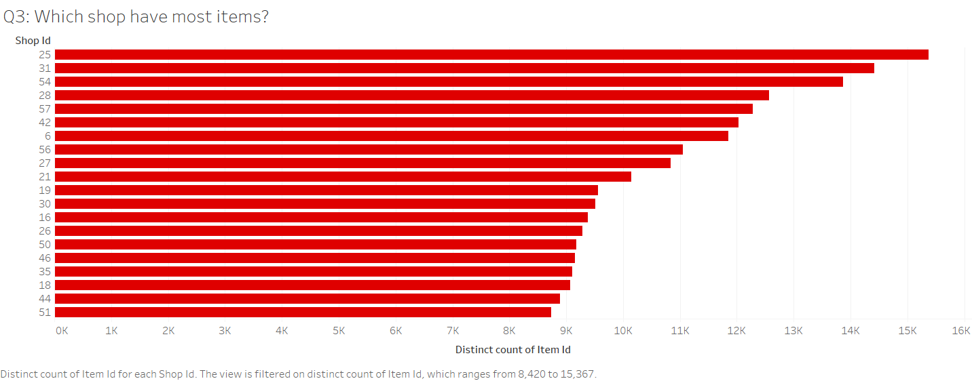
Exploratory Data Analysis
Figure 2.2: Count of Distinct Items of Each Shop

Slide 5
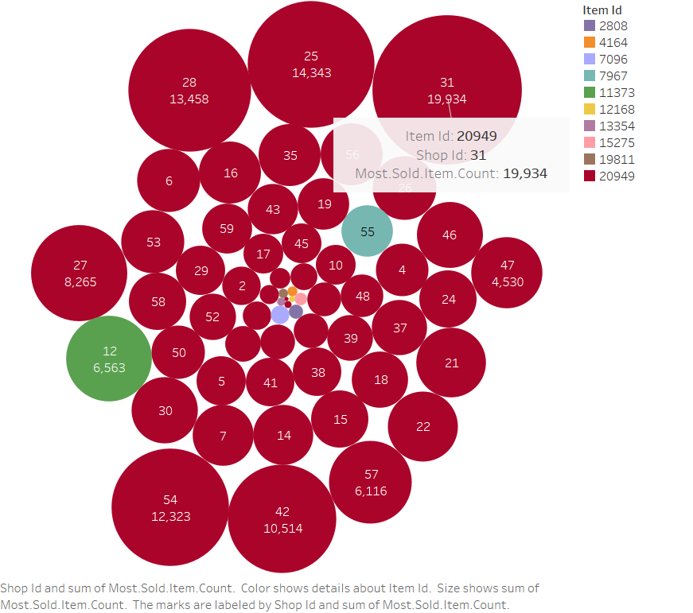
Exploratory Data Analysis
Figure 2.3: Best-Sold Item of Each Shop

Slide 6
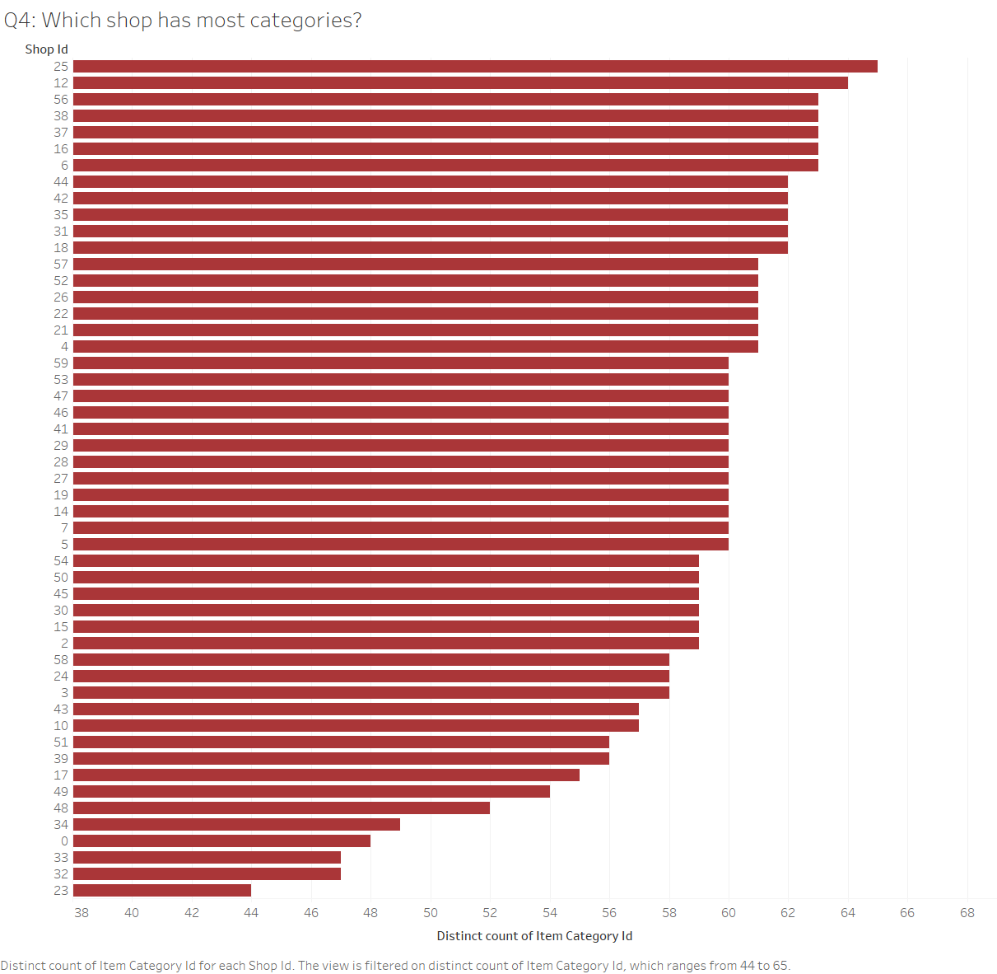
Exploratory Data Analysis
Figure 2.4: Count of Distinct Categories of Each Shop

Slide 7
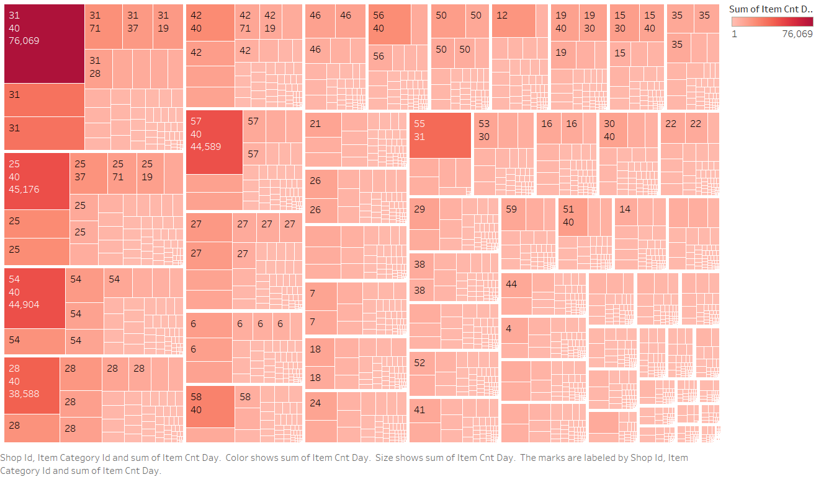
Exploratory Data Analysis
Figure 2.5: Count of items sold of Each Category in Each Shop

Slide 8
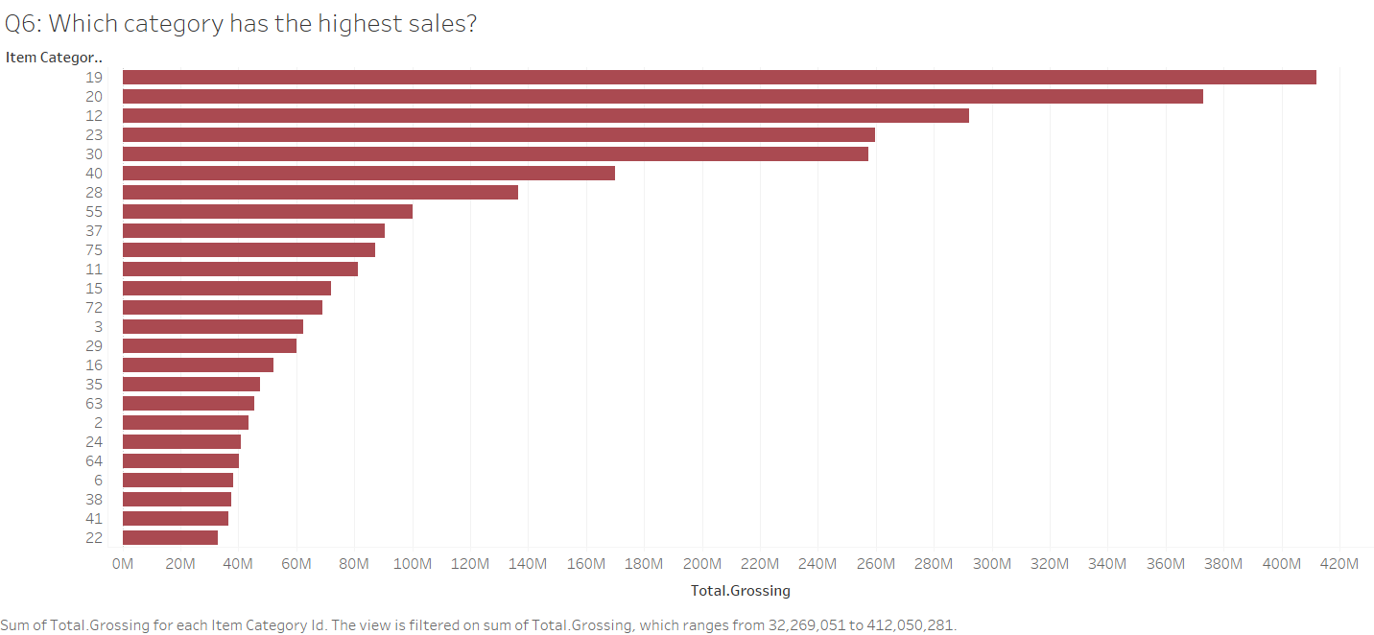
Exploratory Data Analysis
Figure 2.6: Sales of Each Category

Slide 9
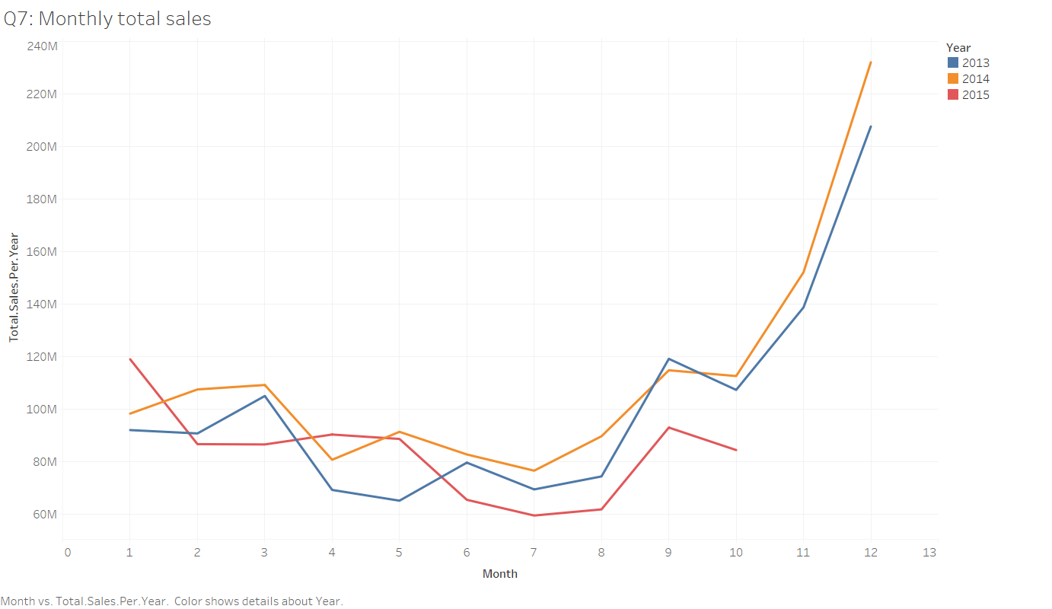
Exploratory Data Analysis
Figure 2.7: Monthly Total Sales Per Year

Slide 10
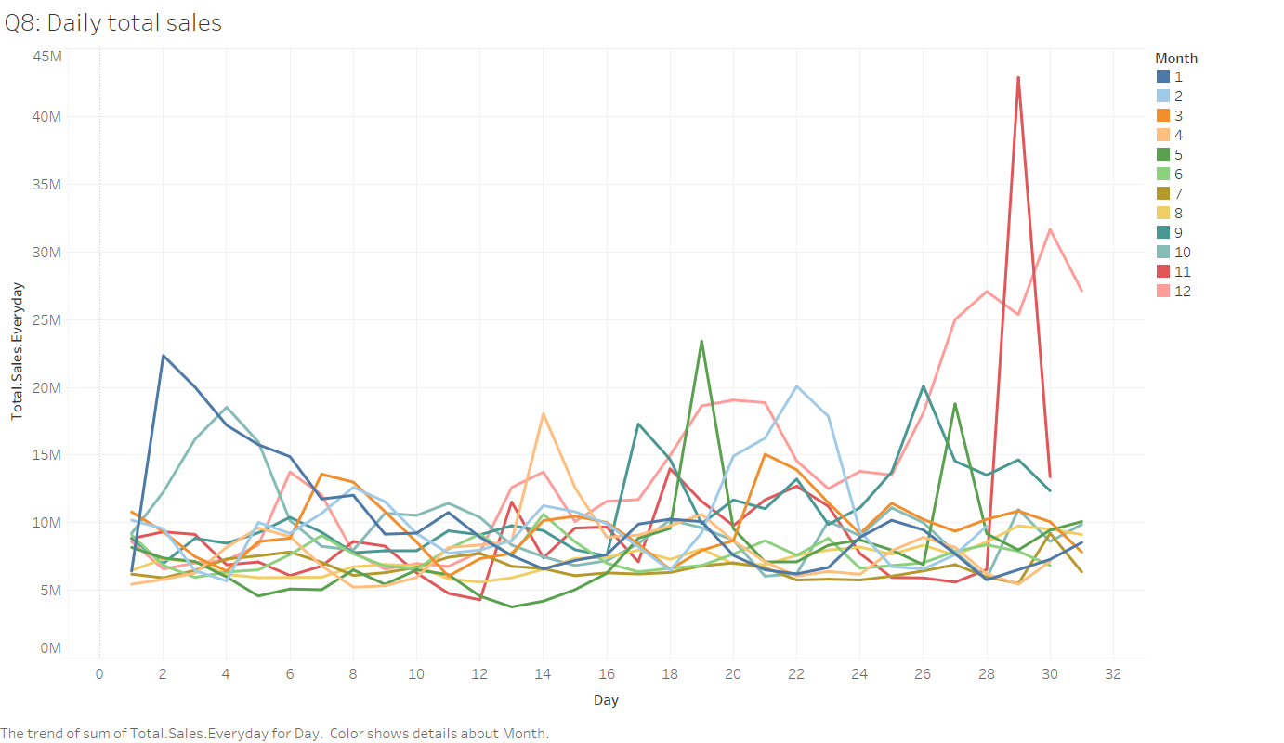
Exploratory Data Analysis
Figure 2.8: Daily Sales Per Month

Slide 11
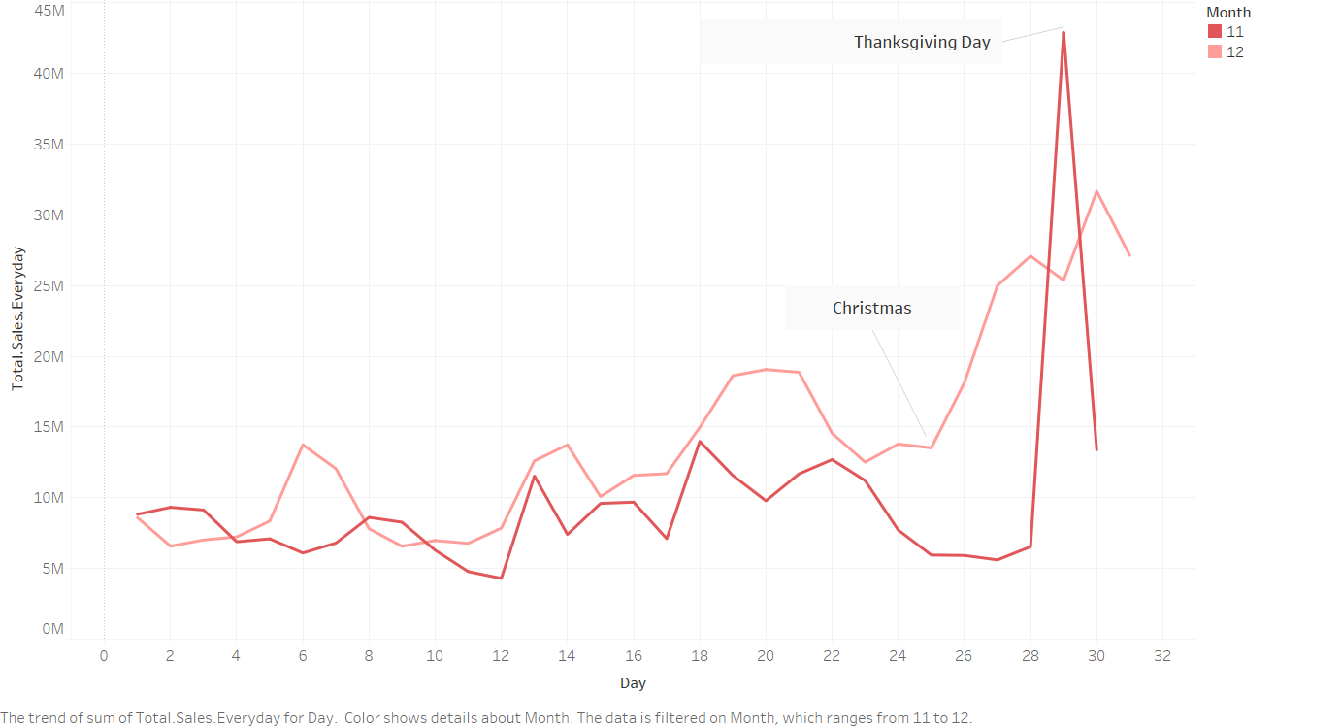
Exploratory Data Analysis
Figure 2.9: Daily Sales in November and December

Slide 12
Modeling Preparation
Data split
Train data: 2013.01.01-2014.12.31
Test data: 2015.01.01-2015.10.31
Evaluation metric
RMSE: Root Mean Square Error
MAPE: Mean absolute percentage error

Slide 13
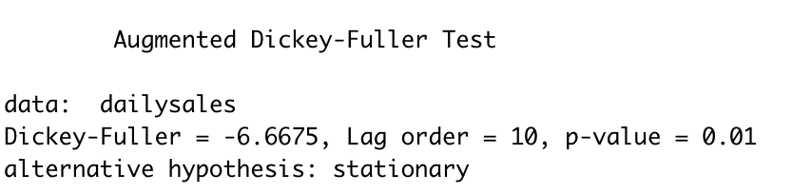
ARIMA Model
Assumptions of ARIMA model
Stationary
Univariate
Notes:
ARIMA model is the combination of AutoRegressive model and Moving Average model. AutoRegressive refers to whether there is some relationship among the lags of differenced series. Moving Average refers to the lags of errors and I I is the number of difference used to make the time series stationary.
Before using ARIMA model, we need to make sure the data is stationary and univariate. Firstly, stationary means that the properties of the series doesn’t depend on the time when it is captured. A white noise series and series with cyclic behavior can also be considered as stationary series. To validate our dataset, we made Dickey–Fuller test. Figure 3.1 is the test result of the data. In the test, the null hypothesis test is the data is non-stationary. The p-value is smaller than 0.05, so we can reject the null hypothesis and the data is stationary. Secondly, the data is univariate because it just has two variables, which are date and sales. It means that we assume the sales are just related to the sales of past value.

Slide 14
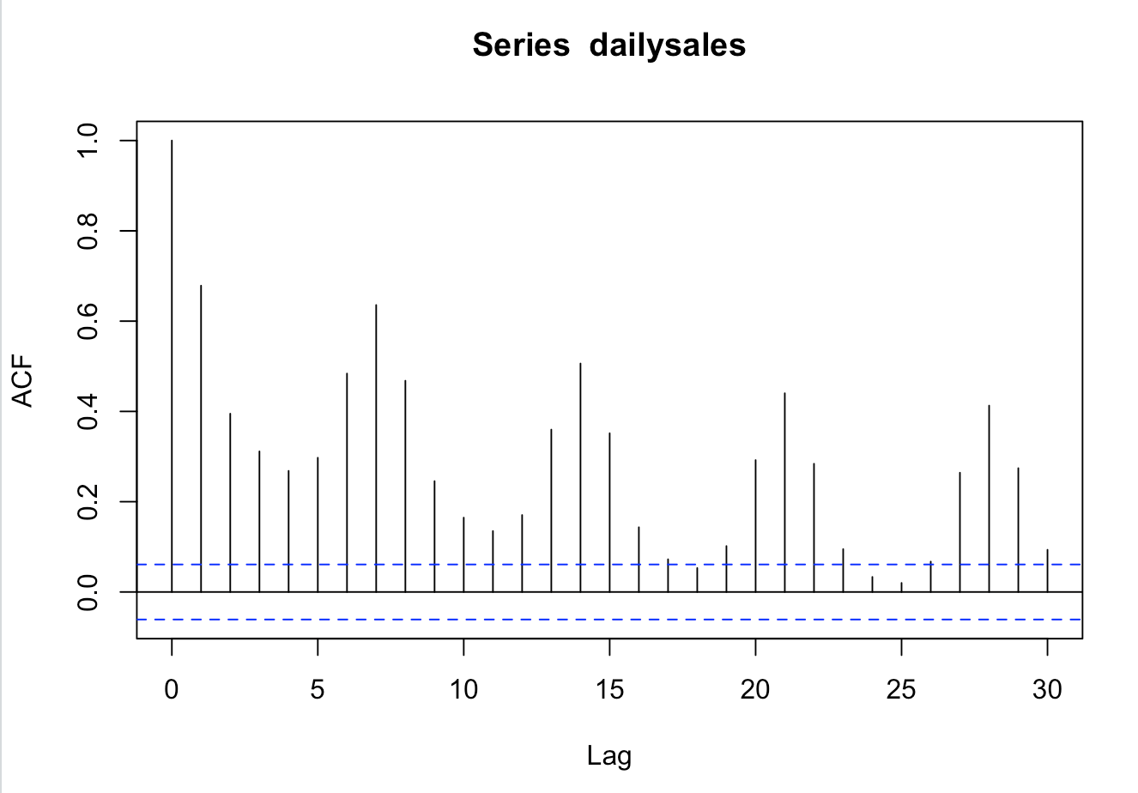
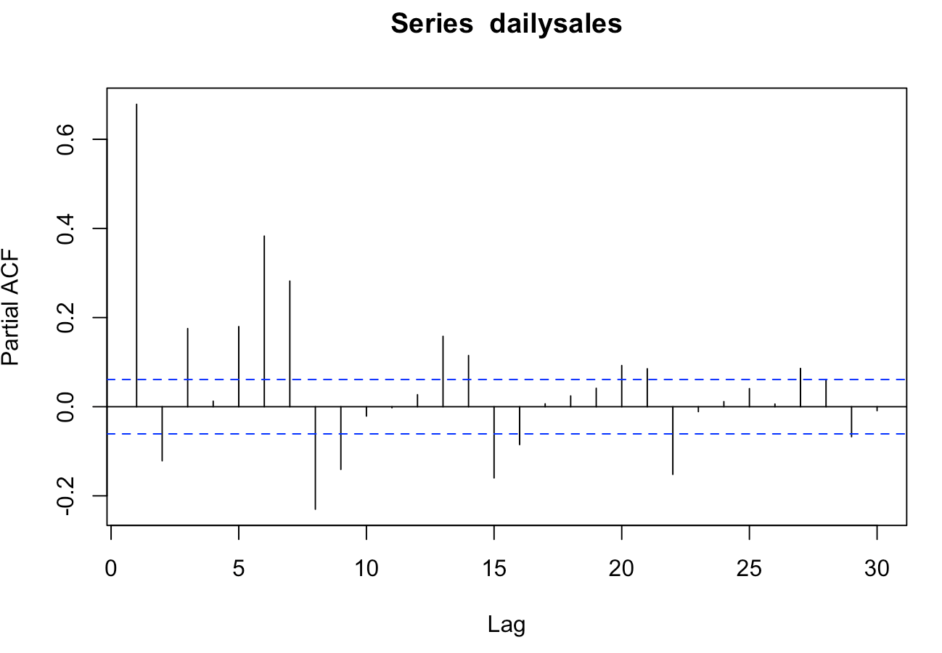
Autocorrelation Analysis
most related to the yesterday and the value before 7 days
seasonal pattern
ACF and PACF has no cut-off
Notes:
After test the assumptions of ARIMA model, we did some exploratory analysis including autocorrelation analysis and trend estimation and decomposition.
Autocorrelation analysis: We used this to examine serial dependence. It can test whether the value in the past has a correlation with the current value so that we can provide the p,d,q estimate for ARIMA models. From Figure 3.2, we can see that a week (seven days) is a seasonal pattern. The value is most related to the yesterday and the value before seven days. From Figure 3.3, we can see that there is a seasonal pattern.
Whether in ACF and PACF plot, there is no cut-off. Therefore, we need to use ARIMA model rather than AR or MA model.

Slide 15
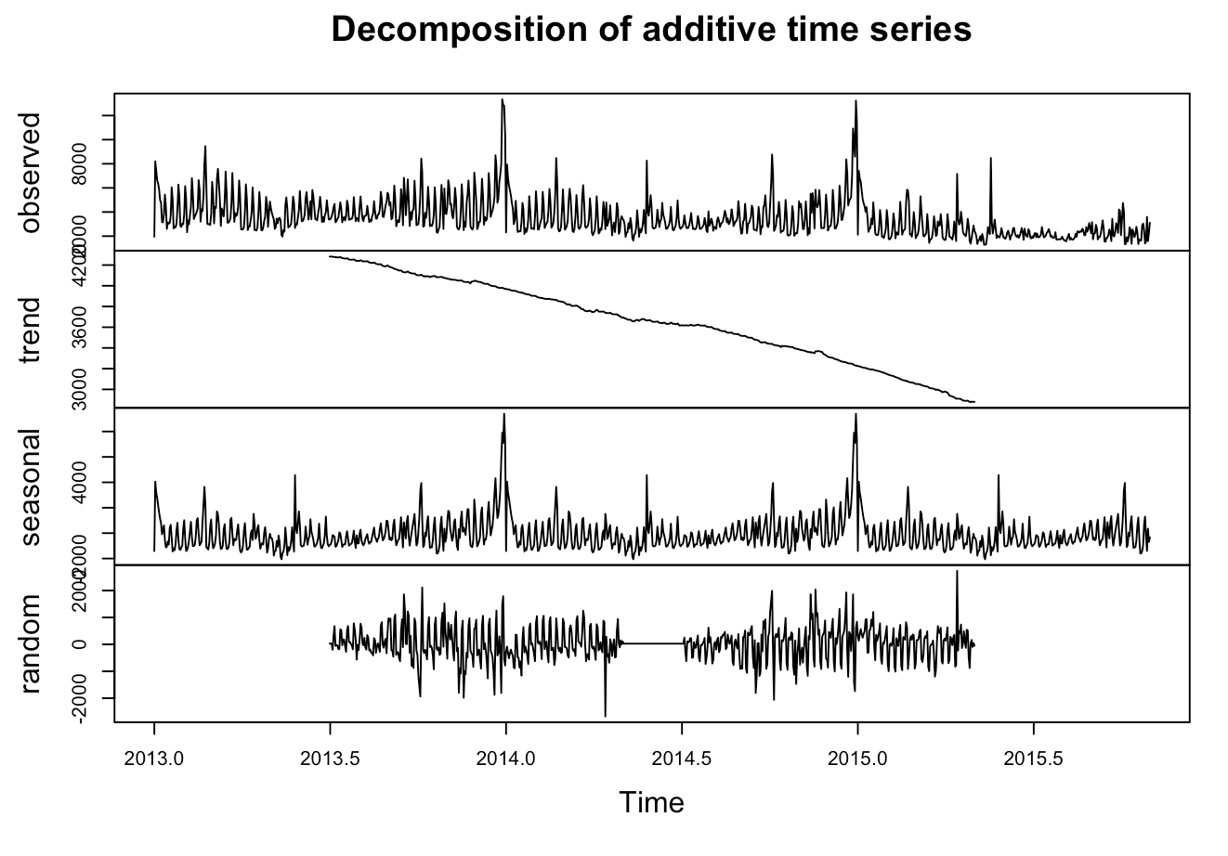
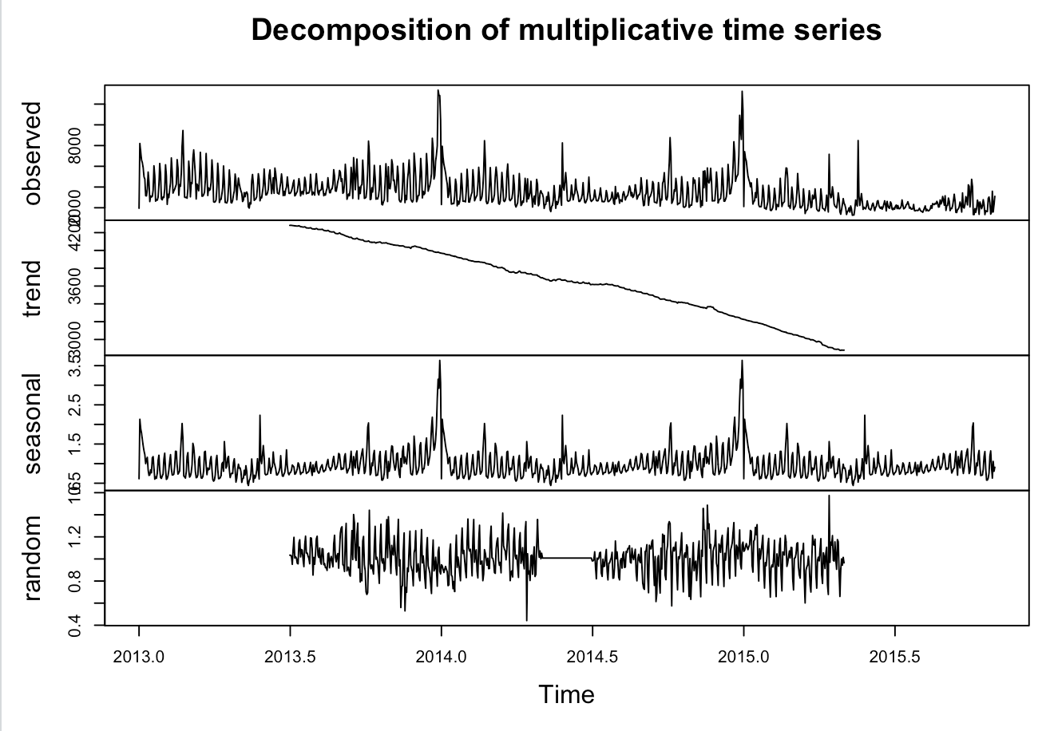
Trend estimation and Decomposition
X= Trend + Seasonal + Random
x = Trend * Seasonal * Random
Notes:
Trend estimation and decomposition: This analysis helps us to analyze the time series components in the data. We used two methods, which are additive and multiplicative decomposition. In additive decomposition, x= Trend + Seasonal + Random and in multiplicative decomposition, x = Trend * Seasonal * Random. In two methods, we both see that the trend is decreasing and there is a seasonal pattern. The random component is stationary.

Slide 16
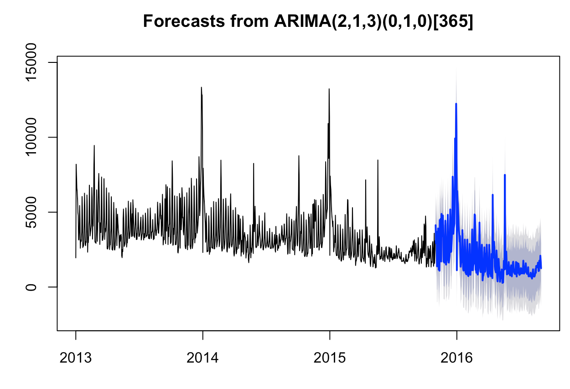
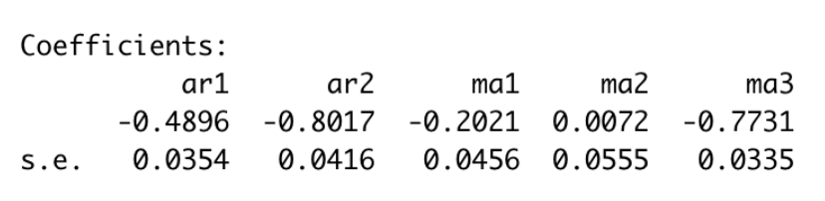
AMRIMA Model Result
RMSE: 898.664
MAPE: 17.35%
First-differenced of Y
Most related to the forecast error of Y before two days and the yesterday forecast error of Y
Also related to the Y before two days ago
Notes:
Using these analysis, we build a ARIMA model which the parametres (2,1,3)(0,1,0). Figure 3.6 shows the model result. The RMSE is 898.664 and MAPE is 17.3475% which means that the mean absolute error of the model is 17%. From the coefficients below, we can see that the model use the first difference of Y. The estimated first difference is most related to the forecast error of Y before two days with an coefficient of 0.0555 and the yesterday forecast error of Y with an coefficient of 0.0456.. It is also related to the Y before two days ago.

Slide 17
Prophet Model
Prophet is an open source software from Facebook and available on R.
It is based on additive model where nonlinear trends are fit with yearly, weekly, and daily seasonality and works well with outliers.
Our sales data has many outliers, especially at the end of the year so that prophet is good to use.
To predict the total sales of the next day, two models are set.
One has the seasonality feature.
The other one does not have the seasonality feature.

Slide 18
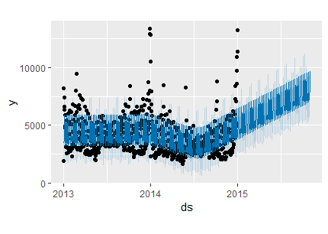
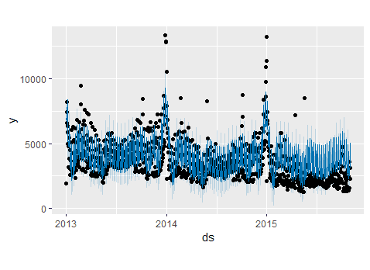
Prophet Model Result
Non-seasonality
RMSE: 2586.42
Seasonality
RMSE: 700.3344

Slide 19
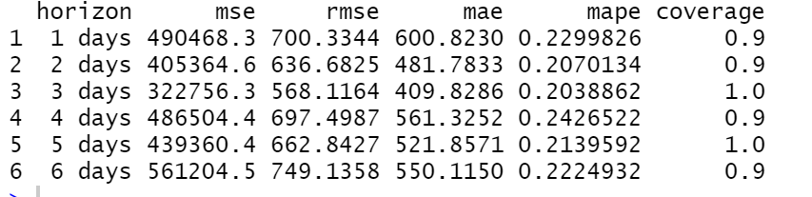
Prophet Model Evaluation
Seasonality
RMSE: 700.3344
MAPE: 0.2299826

Slide 20
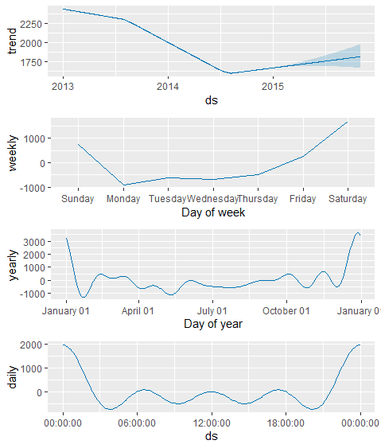
Prophet Model Result Analysis
Trend
Decreased from 2013 to 2014
Increased in the middle of 2014
Weekly
Least sales on Monday
Most sales on Saturday
Yearly
Most sales at the beginning and the end of the year
Daily
Most sale at 12 am

Slide 21
LSTM Model
Long short-term memory is an artificial recurrent neural network architecture with feedback connection.
Since our data is the time series data, LSTM is a well-suited method to make predictions of the daily sales.

Slide 22
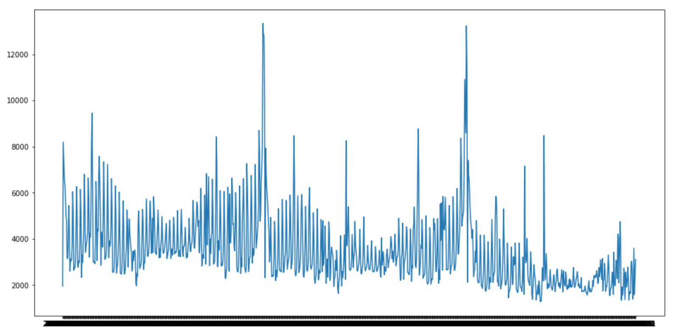
LSTM Model
First glance at the time series model:
Daily sales changed significantly, and daily sales are influenced by many uncertain factors.
Our data started at January 2013, and ended in October 2015.
Annual sales seems to decrease every year.
In the mid of 2015, the performance of the daily sales was the worst.

Slide 23
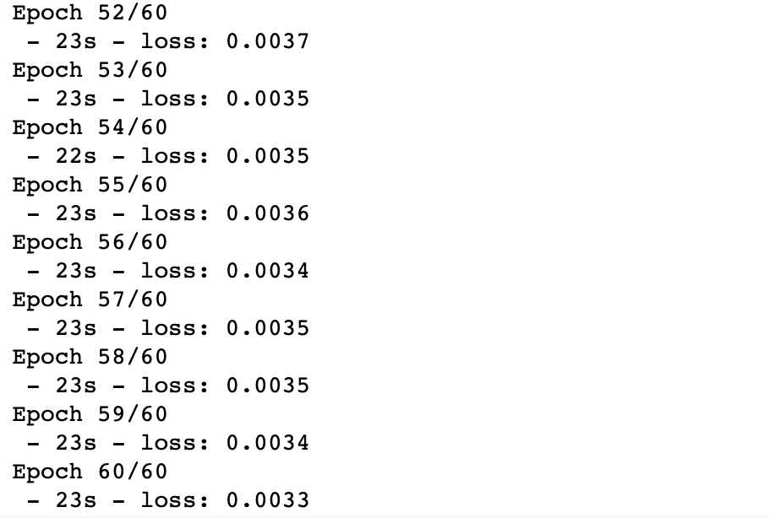
LSTM Model
Create and fit the model…
Create and fit the LSTM network:
Epochs: 60
Batch size: 4
Loss function: mean square error
The best epoch:
The 60th epoch
MSE: 0.0033

Slide 24
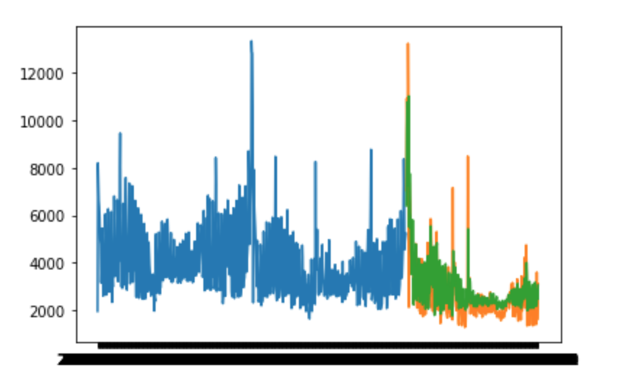
LSTM Model
Model Performance…
RMSE: 322.09
Reason: large daily sales figures
MAPE: 0.14
Green Line: predicted data
Blue Line: training data
Orange Line: actual data
It shows that the model can predict the data precisely
Can be optimized in the future work

Slide 25
Conclusion
Why Arima model has bad performance ?
Data must be stationary.
The model can just recognize linear relationships.
It’s time-consuming to find the best performance.
Why Prophet model has bad performance ?
The daily data is not the actual dealing time.
The trend does not make the right predict.
The large daily sale figure.
Why LSTM model is the best model?
There are unknown durations between important events in a time series.
Recurrent neural network can train the data better.

